Slide 2



REVIEW 3
( UNITS 7 – 8 – 9)
Reading
Speaking
Listening
Writing

Slide 3


Reading
STRANGE SPORTS
Read the two descriptions of strange sports and choose titles for them.
Use the information from the passages above to tick () the correct box.

Slide 4


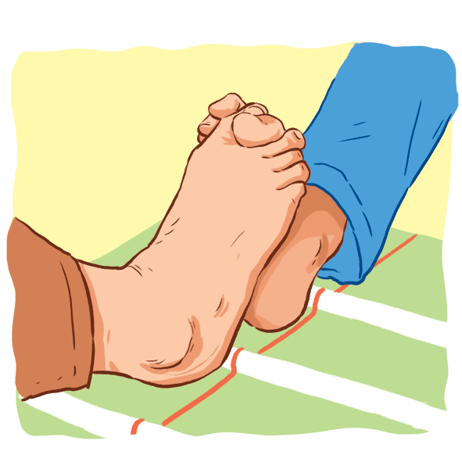
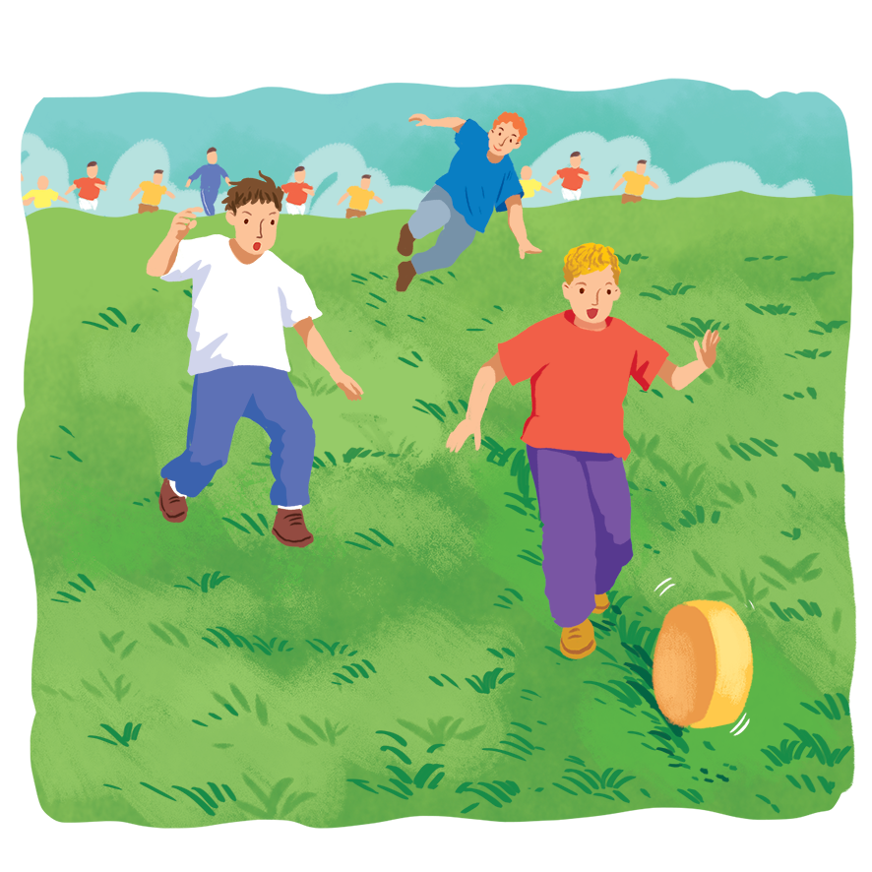
Read the two descriptions of strange sports and choose titles for them.

Slide 5
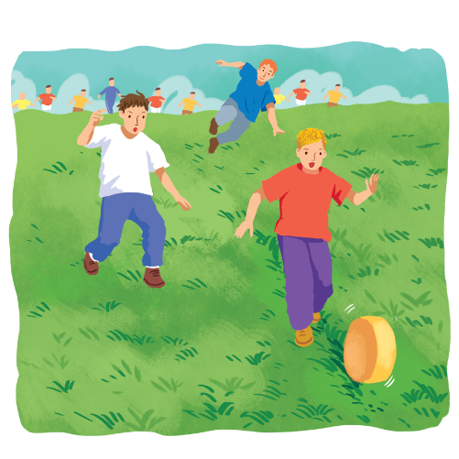
A.
Toe Wrestling
B.
Cheese Rolling
1.
Cheese Rolling
2.
Toe Wrestling
It’s a simple sport. Competitors roll a big round piece of cheese from the top of a hill. Competitors run after it and try to catch it. Very few people can catch it because it goes very fast, about 112 km an hour.
It’s a popular sport for children. This game started in Derbyshire in the North of England. Two children lock their toes together and try to push the other’s foot to the ground. It’s similar to arm wrestling.

Slide 6

Use the information from the passages above to tick () the correct box.
 | Toe Wrestling | Cheese Rolling
1. You need a hill to play this sport.
2. You use the lower part of the body for this sport.
3. It travels at about 112km/h.
4. Not many people can catch it.
5. It first started in England.






Slide 7

Speaking
Work in groups. Interview your classmates about their likes. Take notes of their answers and report to the class.

Slide 8
Work in groups. Interview your classmates about their likes. Take notes of their answers and report to the class.
Questions | Person 1 | Person 2
1. What city would you like to visit?
2. What sports do you like playing?
3. What TV programme do you like watching?

Slide 9

Listening
Listen to a talk about Singapore and fill the missing information.

Slide 10

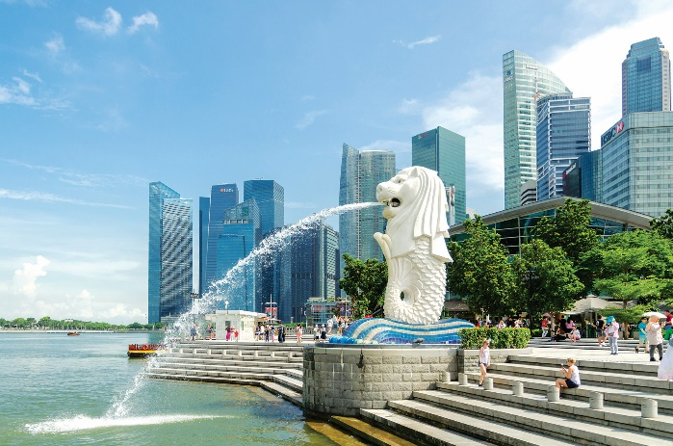
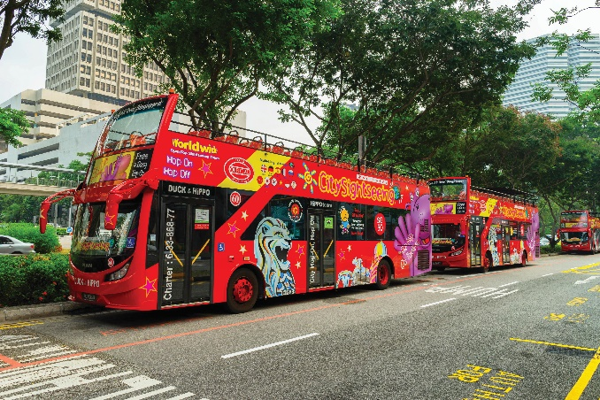
Listen to a talk about Singapore and fill the missing information.
Merlion Park
Hop-on hop-off bus
Singapore attracts millions of (1)
A hop-on hop-off bus goes (2)
The cost of the tour is (3)
The bus comes every (4)
This tour is good for people with (5)
visitors every year.
_______ every year.
slowly around the city.
_______ around the city.
_______ dollars.
35 dollars.
_______ minutes.
30 minutes.
little time.
_______ time.
Audio script

Slide 11
AUDIO SCRIPT
Singapore is a small island city-state. It attracts millions of visitors every year. A good way to see the city is by taking a hop-on hop-off bus. The bus goes slowly around the city. It stops at different attractions like Chinatown and Merlion Park. You can get off the bus at any place, and then get on the next bus. The tour costs 35 dollars, and there is a bus every 30 minutes. This kind of sightseeing is good for people with little time in the city.

Slide 12

Writing
Look at the information on Mark’s visit to India last summer. Write a paragraph of about 50 words about his visit.

Slide 13
Look at the information on Mark’s visit to India last summer. Write a paragraph of about 50 words about his visit.
You can start with:
Last summer, Mark visited Delhi in India.
He _____________________________.
Country | India
Time | 7 days
City | Delhi
Activities | Watch a snake performance Visit temples Eat street food
People | friendly
Weather | hot

Slide 14

